Slide 1


UniManage
Project Guide:
Prof. Shruti Dangarh
Submitted by:
Divyang Chavda (MCA2302142)
Mayuri Tukadiya (MCA2302140)
Ronak Vora (MCA2302018)
Sumit Kumar (MCA2302120)

Slide 2
UNIMANAGE : Retail Management System
Our online management system is meticulously designed to provide a seamless and user-friendly interface for shop owners, enabling them to effortlessly manage various aspects of their business.
From inventory control and order processing to customer engagement and data analytics.

Slide 3
Introduction
UniManage System focuses on providing a user-friendly interface, empowering shop owners to effortlessly oversee various business aspects.
This includes inventory control, order processing, customer engagement, and data analytics.
The UniManage System is poised to redefine how businesses operate and manage their retail ventures in an ever-evolving digital landscape, offering a comprehensive solution that prioritizes efficiency, security, and ease of use.

Slide 4
Features and Advantages of the project
• Inventory Management:
The system offers robust inventory management tools, allowing retail owners to track stock levels, receive alerts for low inventory, and streamline the ordering process.
• Sales and Order Processing:
It provides an efficient sales and order processing system, enabling businesses to process customer orders, generate invoices, and manage order fulfillment seamlessly.

Slide 5
Features and Advantages of the project
• Supplier Management:
Retail owners can manage relationships with suppliers, monitor deliveries, and update product catalogs with ease.
• Billing Process:
The billing process feature automates the generation and management of invoices for customer purchases. It calculates costs, taxes, and discounts accurately, providing a seamless and transparent billing experience for customers.

Slide 6
Features and Advantages of the project
• Deposit and Lending:
It allows the owner to manage incoming and outgoing financial transactions, including customer payments, refunds, and business loans.
• Sales Monitoring:
The sales monitoring feature provides a comprehensive overview of all sales activities within the retail enterprise. It tracks sales in real-time, allowing the owner to analyze trends, identify top- selling products, and recognize peak sales periods.

Slide 7
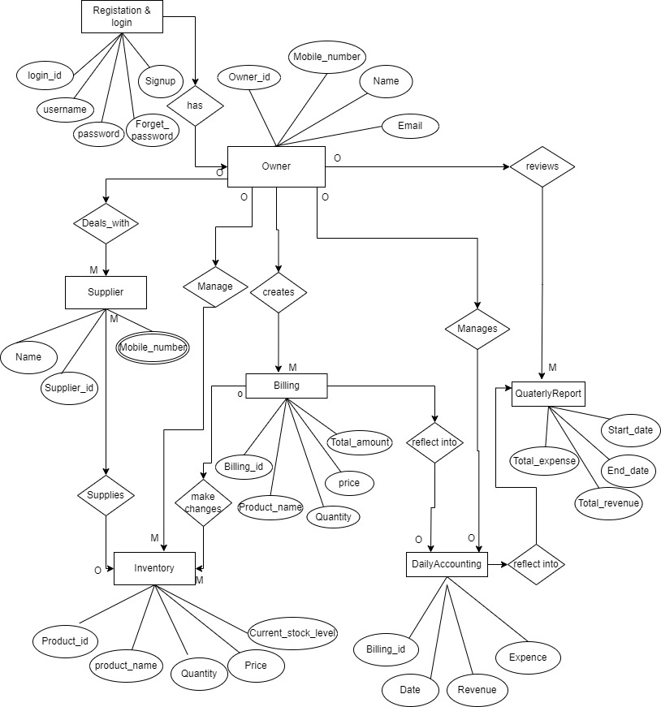
ER Diagram

Slide 8
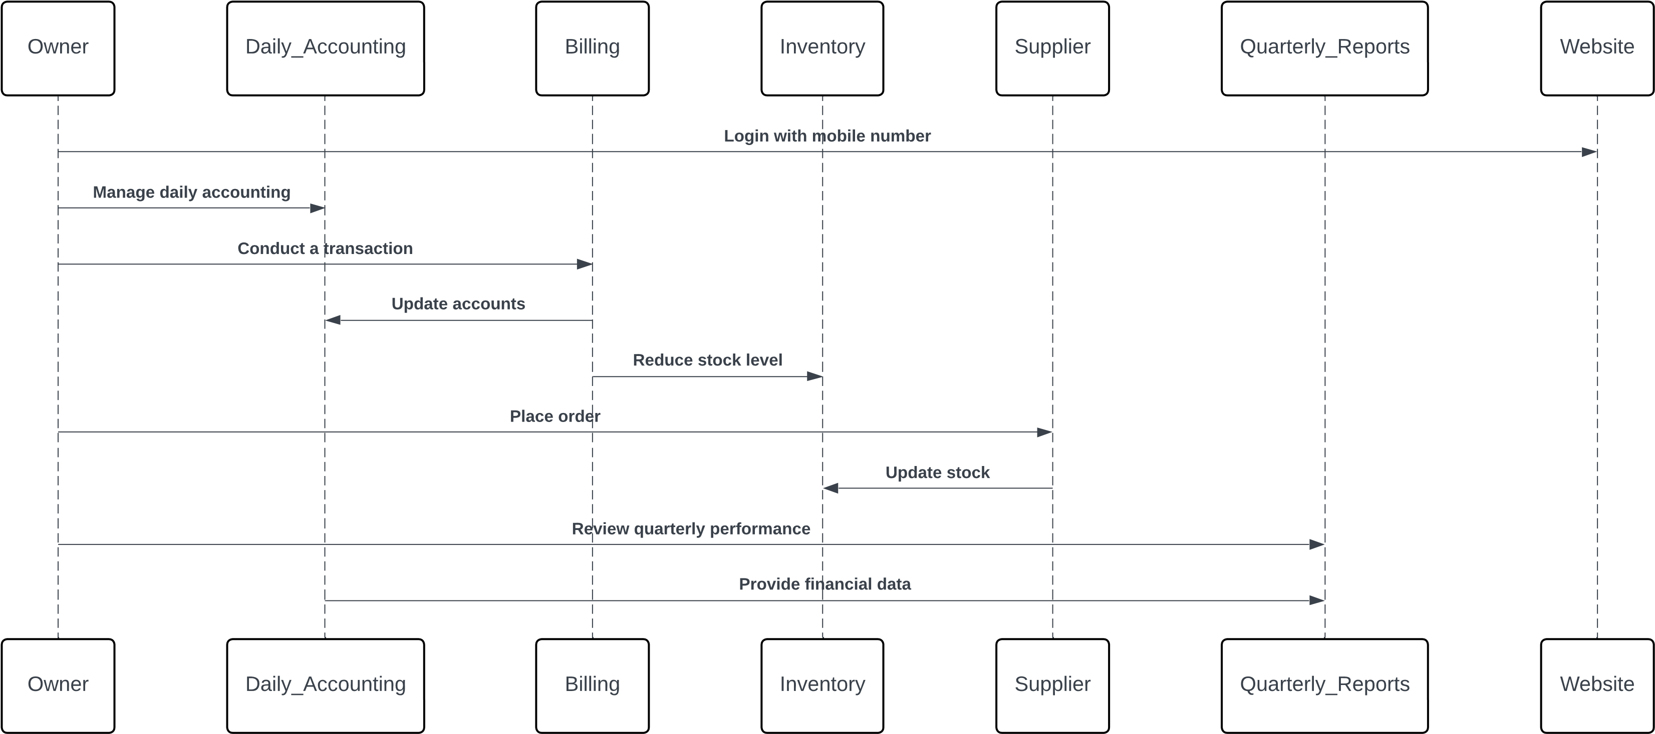
Sequence Diagram

Slide 9
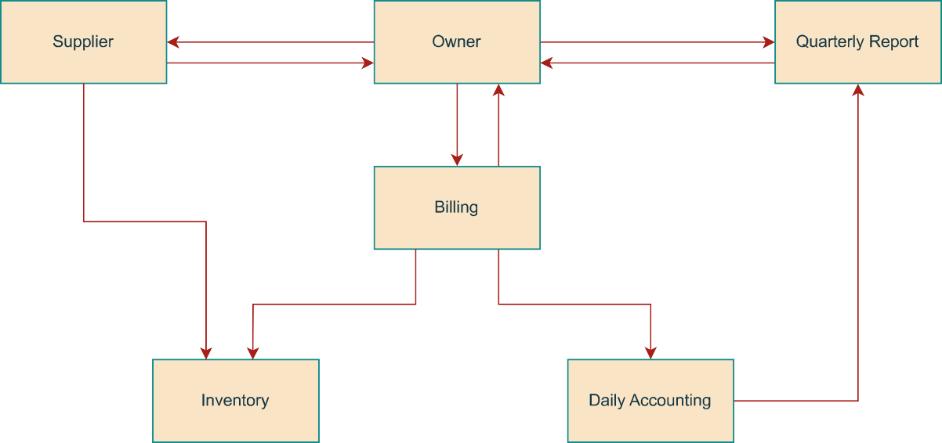
Data flow diagram
0 Level

Slide 10
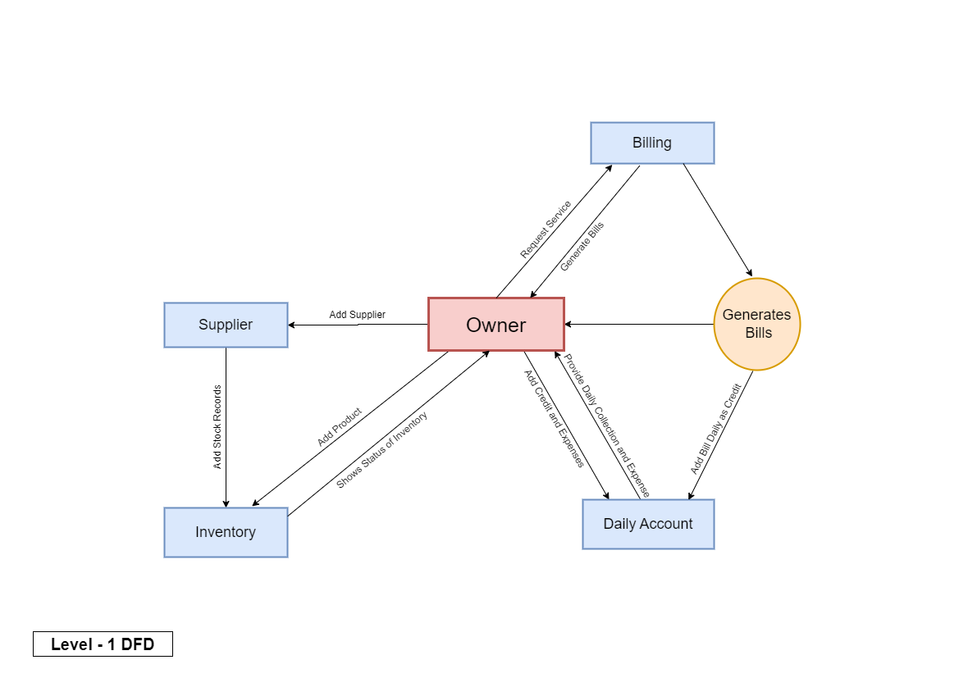

Slide 11
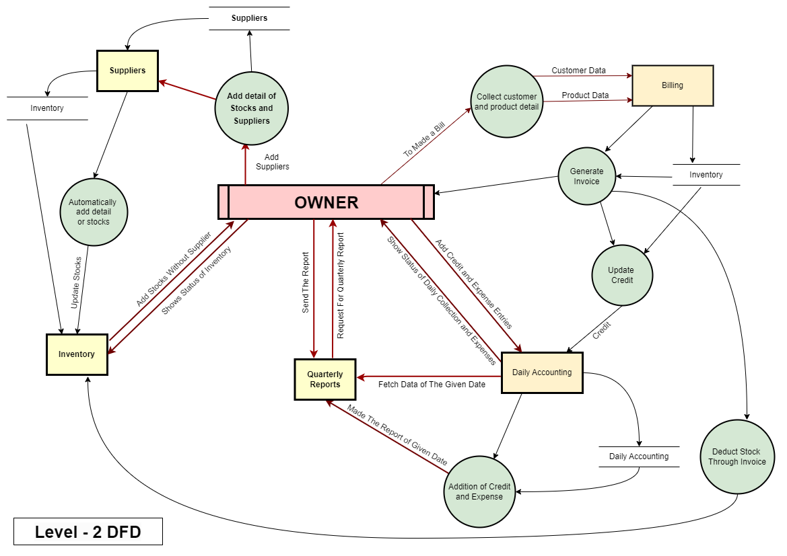

Slide 12
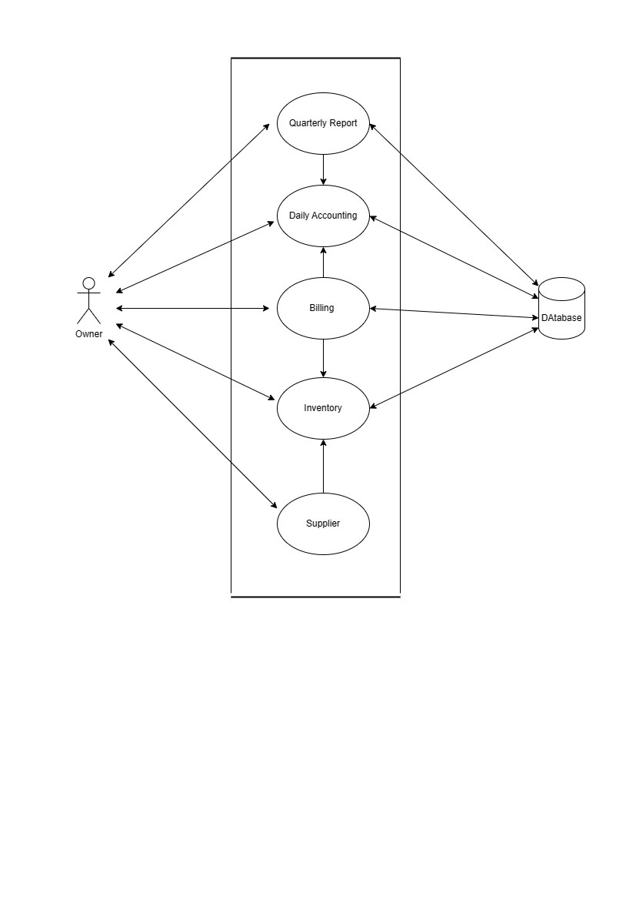
Use Case Diagram

Slide 13
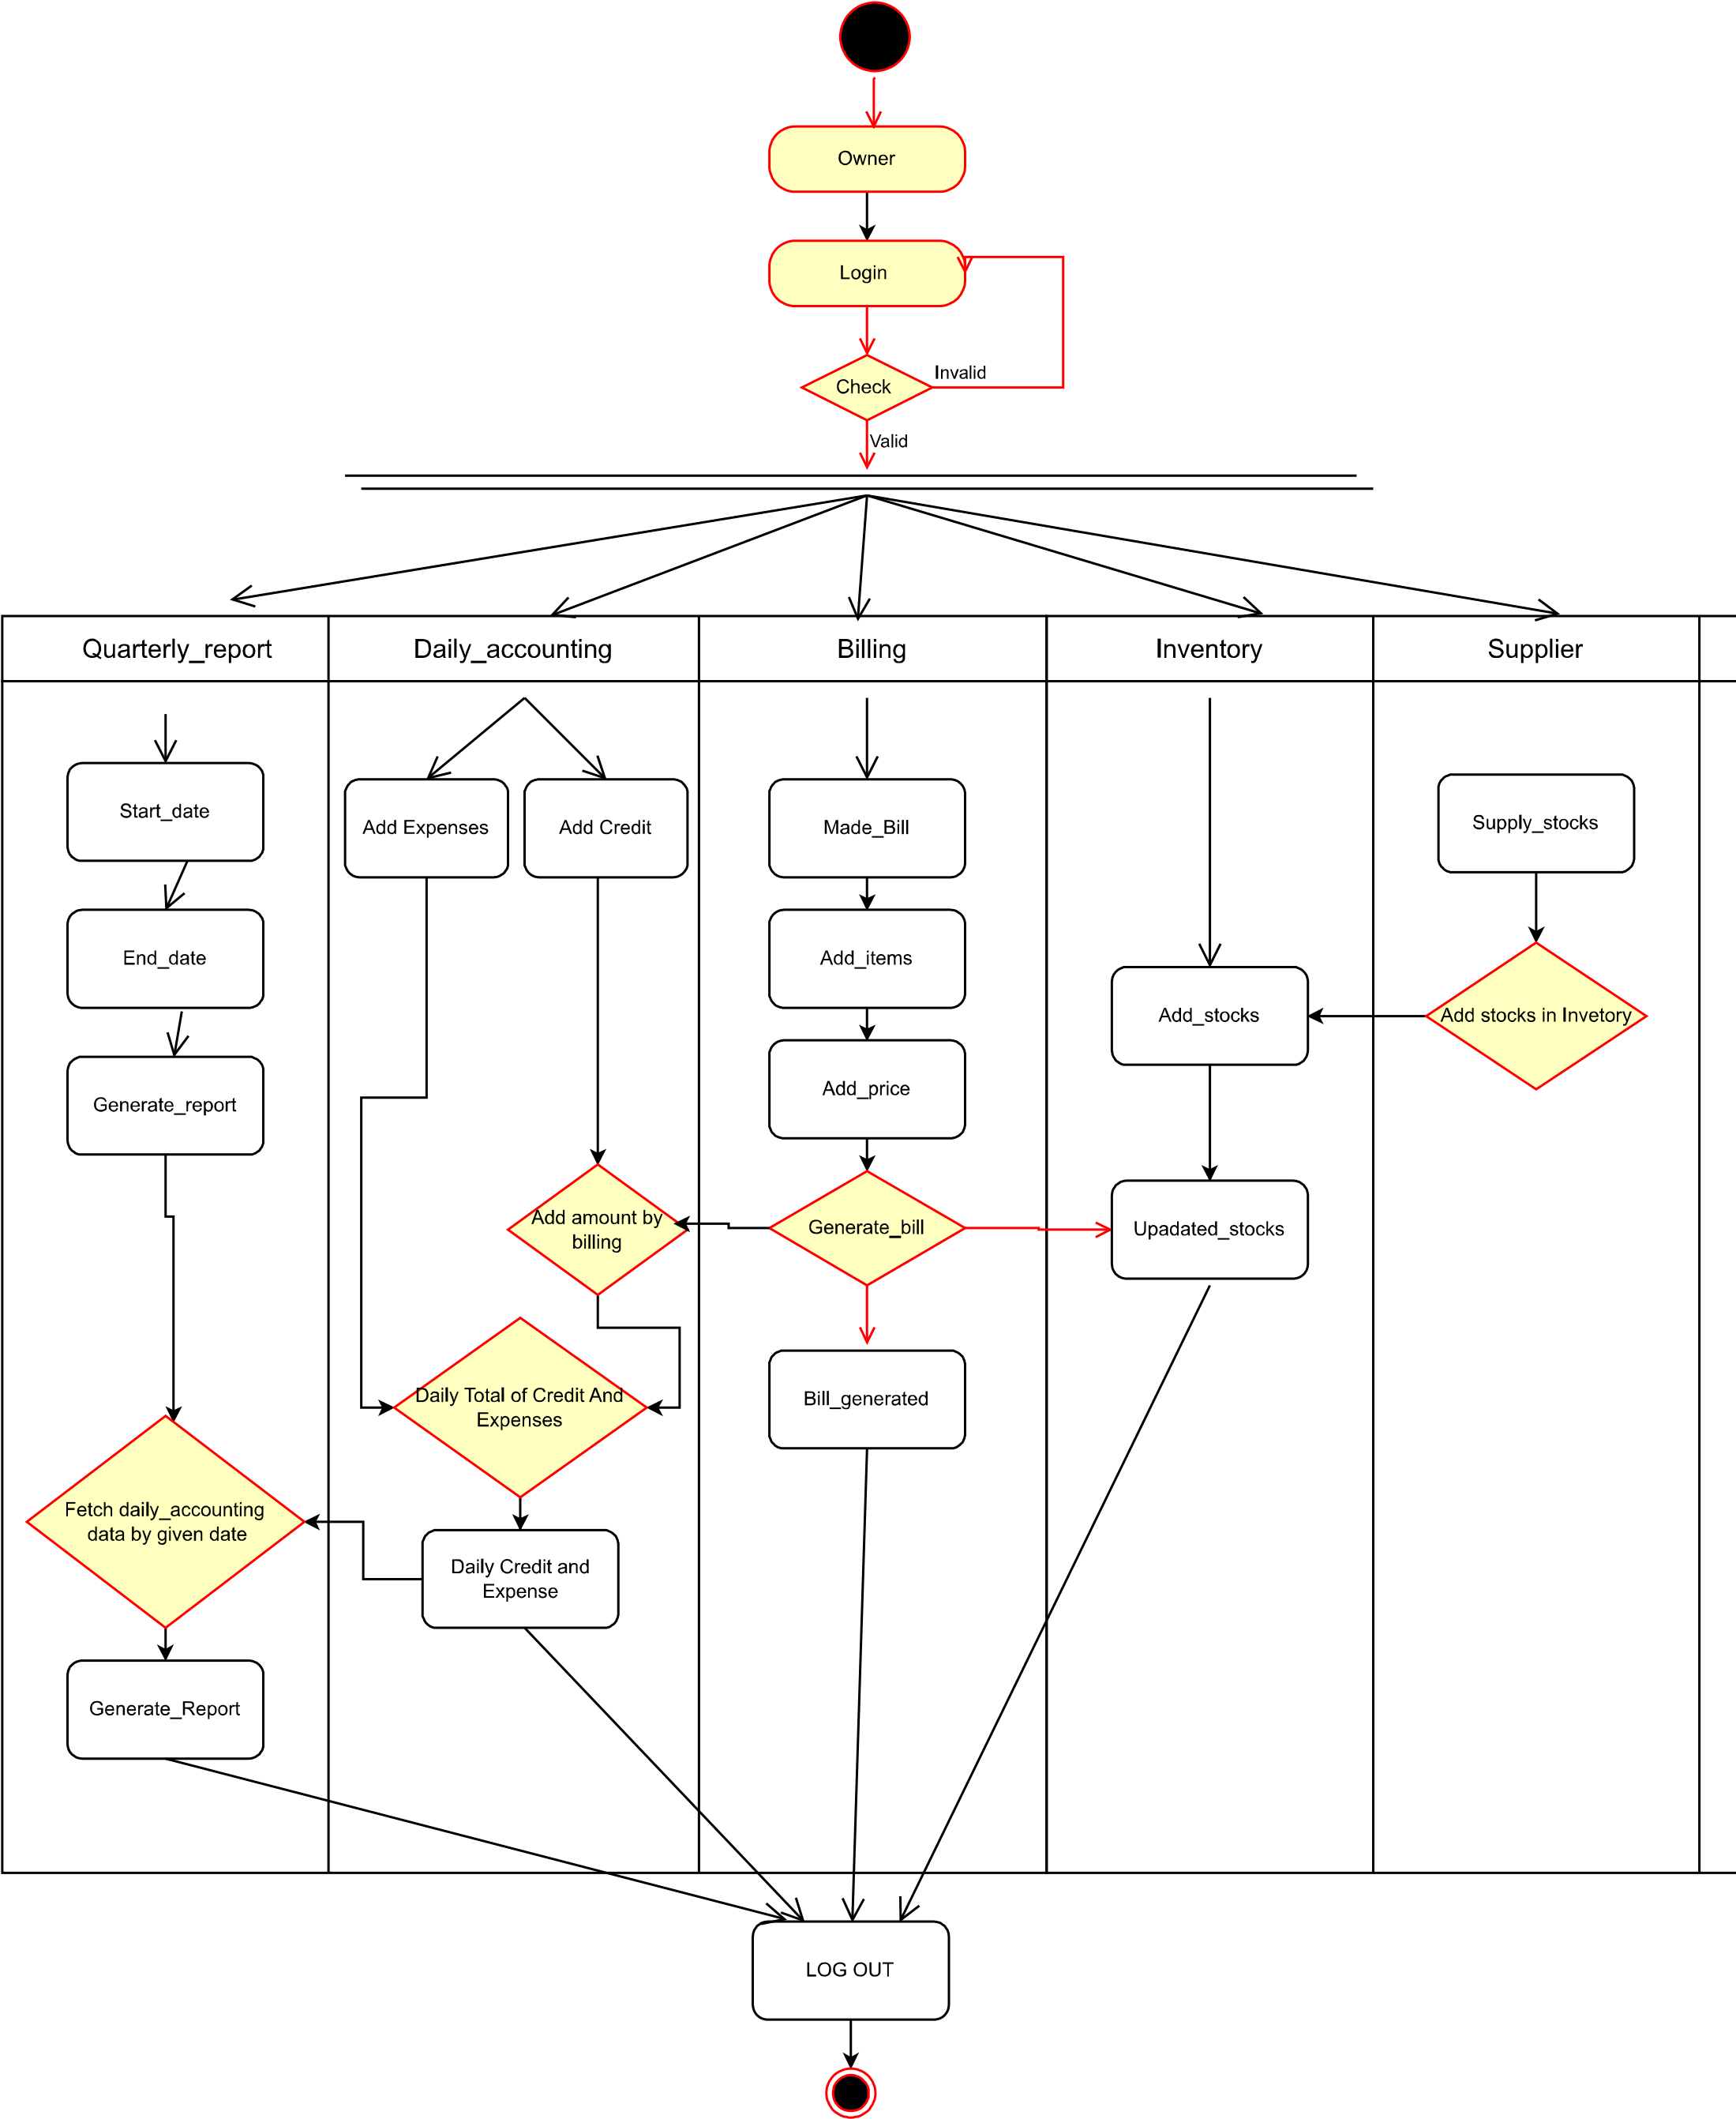
Activity Diagram

Slide 14
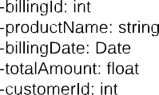
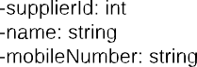
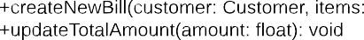
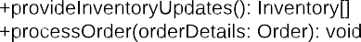
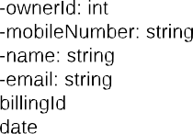
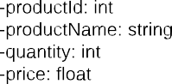
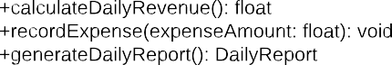
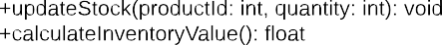
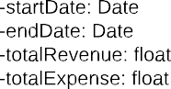
Class Diagram
_____________________________
_____________________________
__________________________
__________________________

Slide 15
Thank You

